Slide 1

Investment Proposal to Ms Alexandra
Portfolio Managers
Achuta Mukund Harsha
Priya G Rao
Rahul Panpatil

Slide 2

Agenda
Background
Objective
Key Findings
Recommendations
Appendix
Approach

Slide 3




Background
Potential Client- Ms Alexandra Kolishnyick
Daughter of a famous Ukranian business tycoon
Based in US for her schooling
Believes in humble and simple living
Future Goals
Presently pursuing Bachelor’s and a good student
Intends to form a NGO with friends to support sub-Saharan African Region after college
Emotionally supported by family on the NGO cause
Financials
Huge savings from money sent by parents for expenses till date
Wants to invest the saved money during her college to use the matured amount for NGO
Has refused help from parents in establishing the NGO
Investor Persona
Not eager to disclose any information on investment amount
Wants a comprehensive report on metrics used to devise the investment strategy
Risk Profile: Wants to invest in stocks which show promise but are also stable

Slide 4
Objective
Improve our shared understanding of performance metrics of stocks in various sectors and market index S&P500
Formulate an investment strategy inline with the financial goals
Provide recommendations for investments in stocks offering stable returns consistently.

Slide 5
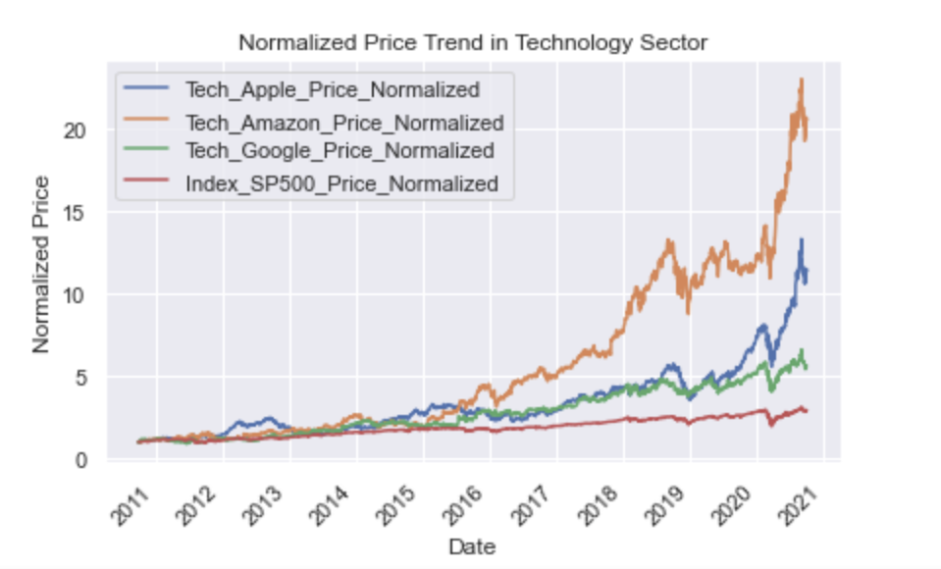
Key Finding
Technology stocks outperform market index
Apple, Google and Amazon has consistently outperformed Market Index S&P 500 since mid 2015
Even during the pandemic, technology stock have recovered after the initial setback in early 2020
Price Fluctuations are less in Apple and Google stocks.
* Prices have been normalized to bring it a comparable scale

Slide 6
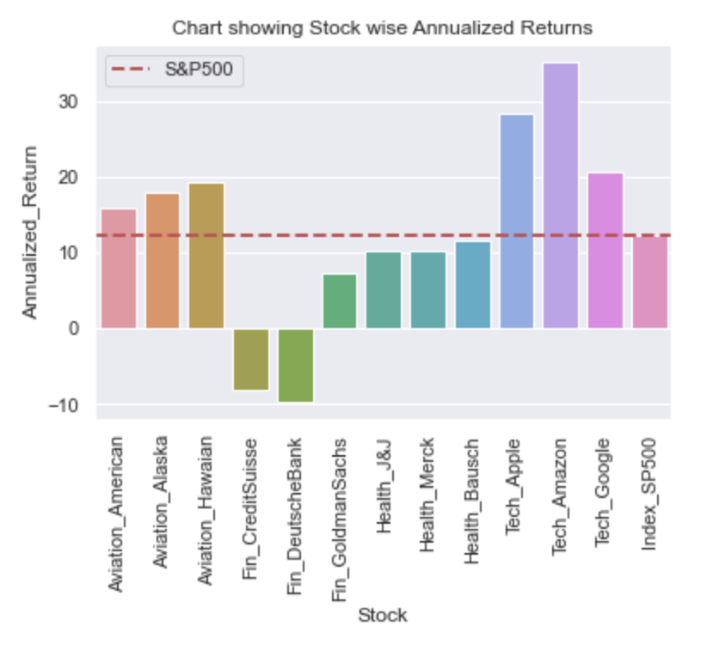
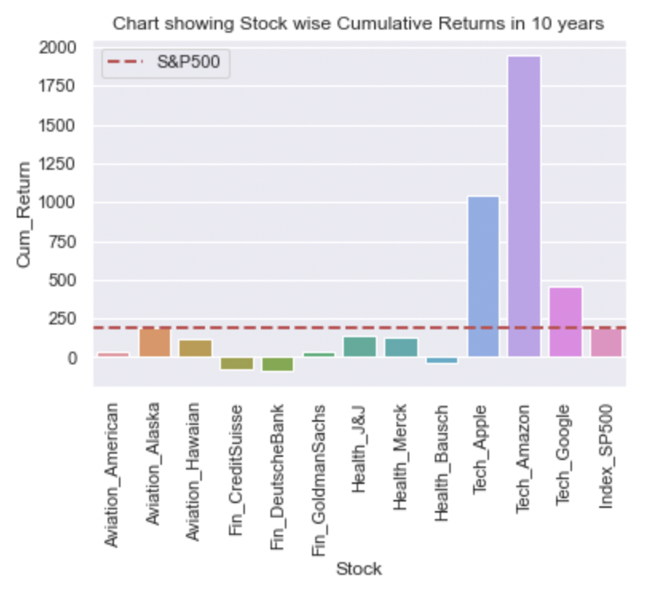
Annualized and Cumulative Returns
Though stocks in Aviation Sector have higher Annualized Return than Market Index, Cumulative Returns are less.
Credit Suisse and Deutsche Bank in Finance Sector have negative Annualized Returns
Bausch Health has negative Cumulative Returns and higher dispersion from Mean Returns.

Slide 7
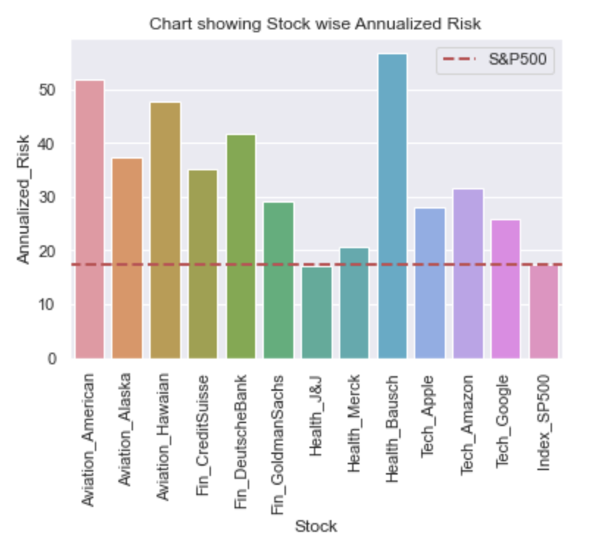
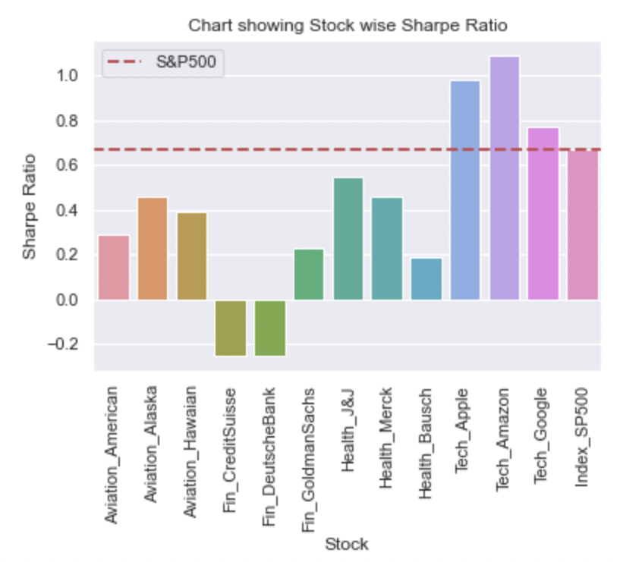
Annualized Risk and Sharpe Ratio
Technology Stocks have moderate risk but higher Sharpe Ratio indicating returns compensate the risk undertaken.
Among technology stocks, Amazon is riskier( Annualized Risk -31.57), with more fluctuations in returns.
Aviation and Finance Sector stocks are highly risky.

Slide 8
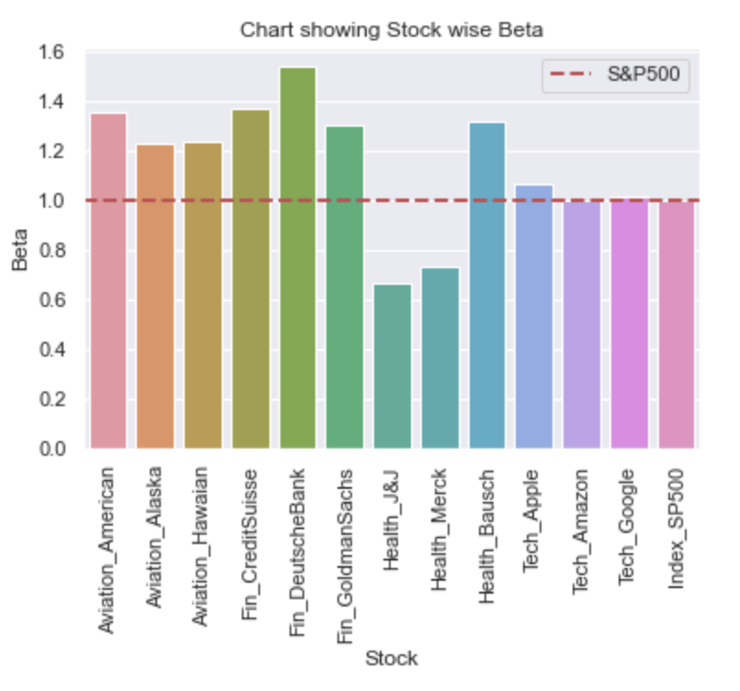
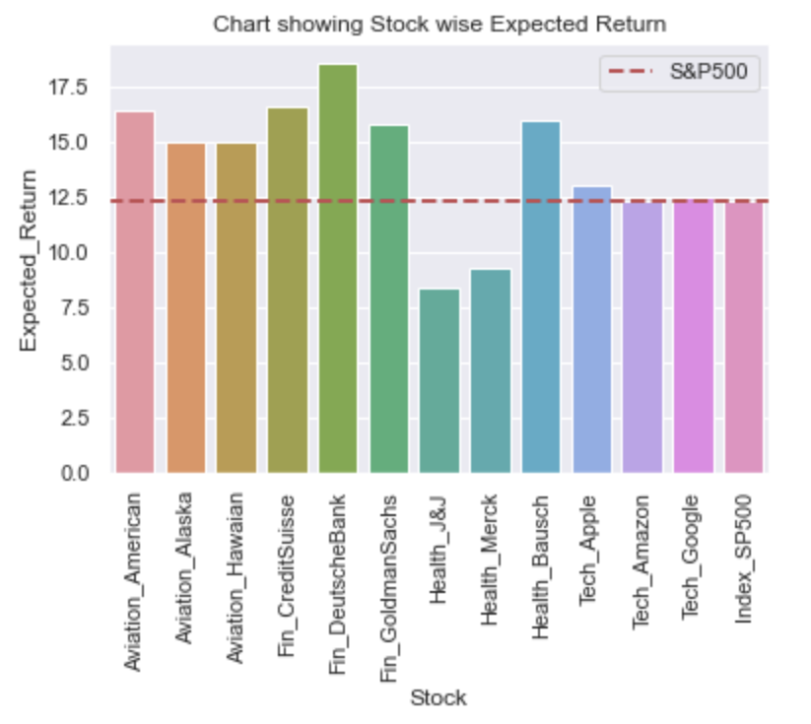
Beta and Expected Return
Technology Stocks have a Beta around 1 ; Expected Returns close to Market Returns.
Riskier stocks in Aviation and Finance Sector have high Beta and promise higher Returns but poor past performance

Slide 9
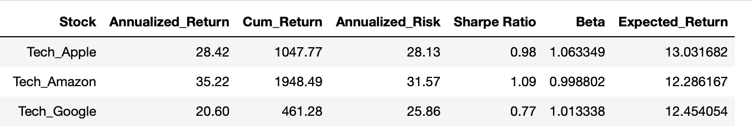
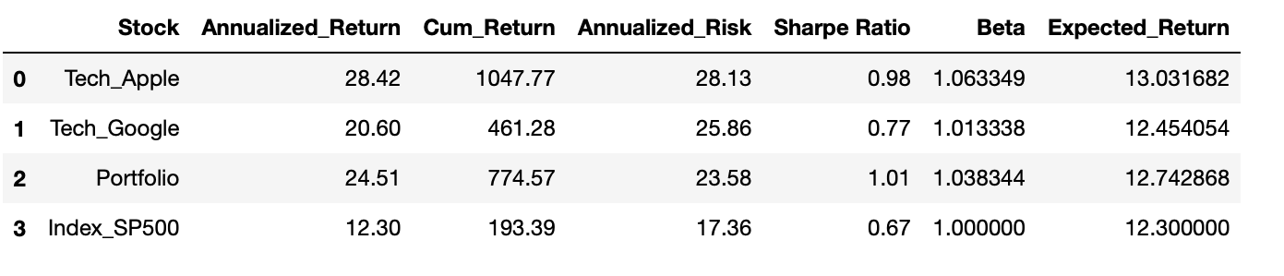
Portfolio Mix Comparison
Expected Return from portfolio of all Technology Stocks – 12.59%
Amazon stock is very volatile ; Expected Returns (12.28%) is less than Market Returns
Amazon Return has weak correlation with S&P500 (0.55)
Performance of Portfolio improves(12.74%) if we drop Amazon stock
Portfolio comprising Apple and Google Stock
Proposal: Invest in Google and Apple Stock for stable and consistent returns

Slide 10
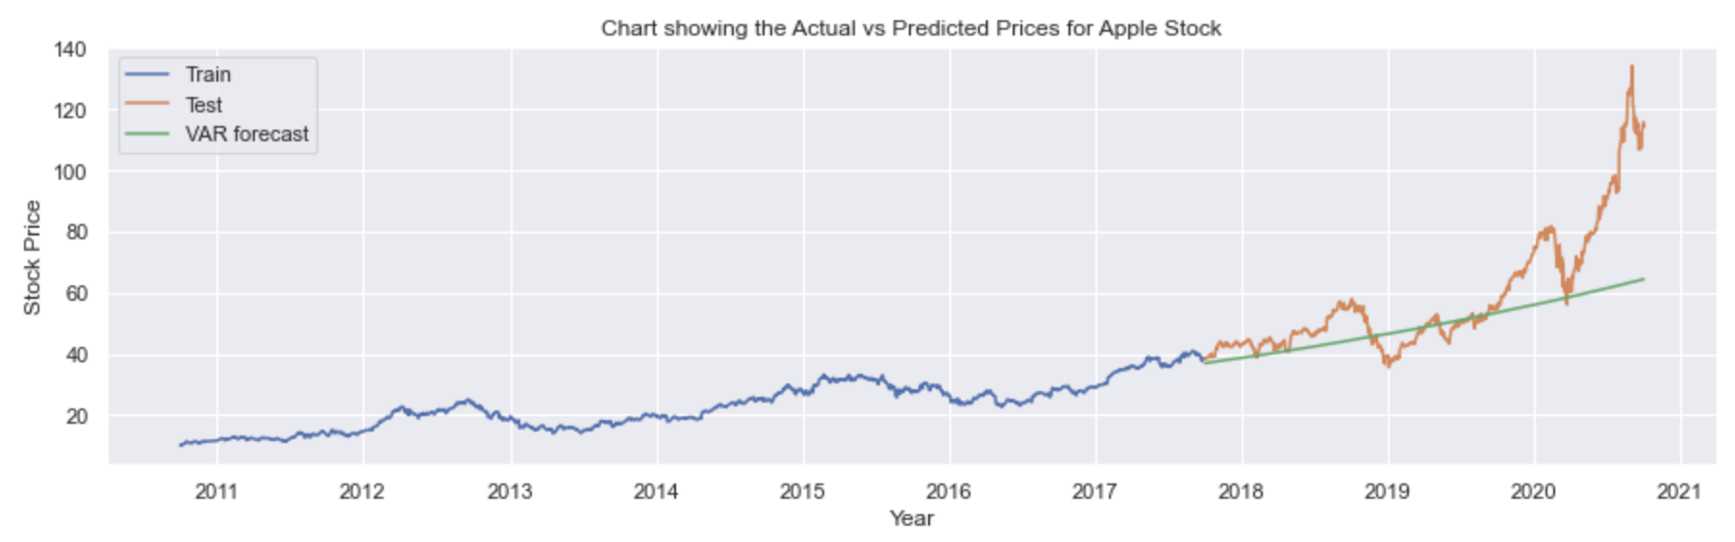
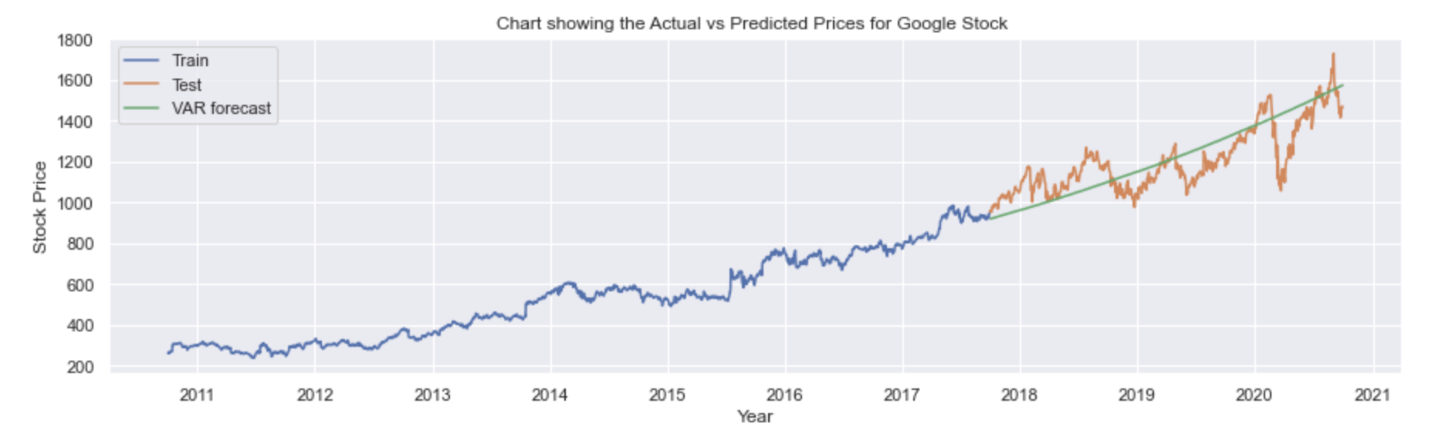
Upward trend in Machine Learning models built on Apple and Google Stock
Multivariate VAR Model built can be used for Stock Price Prediction
Model is built using Price and Relative Strength
Model built for Apple Stock has a MAPE 14.55 of and RMSE of 16.61
Model built for Google Stock has a MAPE 7.41and RMSE of 105.76

Slide 11
Recommendations
Financial goal of the client can be achieved by
Investment in Apple and Google Stock in equal proportion
Overall portfolio can yield Annualized Return of 18.28%
ML model shows Apple Stock has the potential to yield yearly return of 18.59% and cumulative return of 110% in 4 years
ML model on Google Stock shows that the stock can yield 17.98% return yearly and cumulative return of 105.08%
Perdiodic Review of the Investment Portfolio at quarterly intervals

Slide 12
Appendix
Approach
Understanding the Client and the challenges using 5Ws+HOW Framework
Data Understanding and Preparation
Data Exploration and Visualisation
Stock Analysis and Portfolio Management using CAPM
Stock Price Prediction- Validation
Reporting and Conclusion

Slide 13
Thank You

